Slide 1
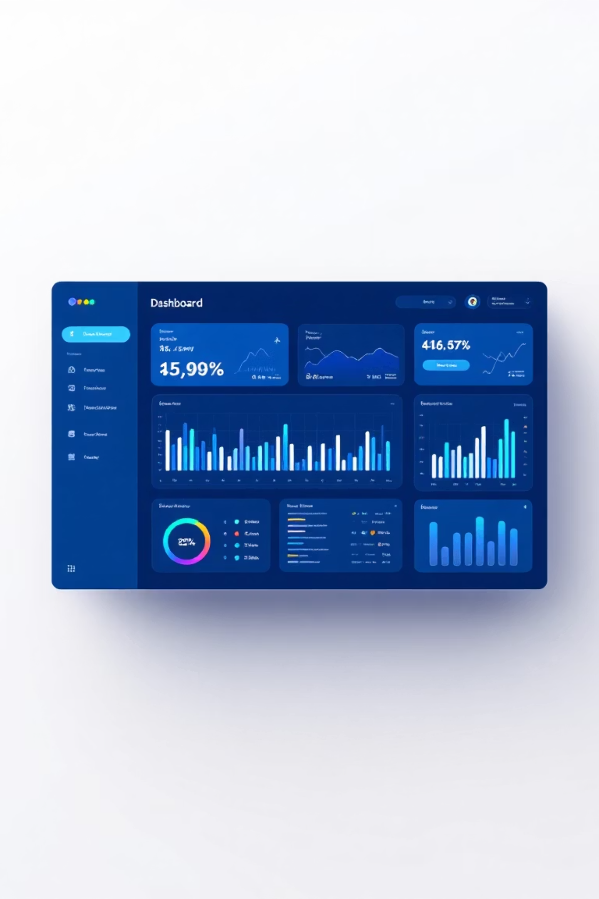
Smart Delivery Dashboard
A frontend-focused application transforming delivery management through intuitive design

Slide 2
Simplifying Delivery Management
The Challenge
Our Solution
Managing delivery operations manually creates inefficiency and confusion. Organizations struggle with tracking orders, lack centralized delivery updates, and have poor visibility into driver status.
A modern, frontend-based application designed to consolidate delivery management into one accessible platform. The interface enables users to view orders, monitor drivers, and access critical delivery information seamlessly.
Our Smart Delivery Dashboard addresses these challenges through a carefully crafted user interface that prioritizes clarity and organization.
The focus: creating a clean, user-friendly experience that puts essential information at users' fingertips.

Slide 3

Core Objectives
Visual Clarity
Data Organization
Create an intuitive interface that presents complex delivery data in an immediately understandable format
Structure delivery information logically, making it easy to find and interpret key metrics
Easy Navigation
Enhanced Experience
Design seamless movement between sections with clear pathways and consistent patterns
Deliver simple, responsive layouts that adapt beautifully across different screen sizes

Slide 4
Design Philosophy
Our UI/UX approach follows a minimal and modern design strategy, prioritizing user comprehension and efficient information delivery.
01
02
03
Simple Color Themes
Consistent Layout
Clear Typography
Carefully selected palettes improve readability and reduce cognitive load
Unified structure across all pages creates familiarity and confidence
Strategic font choices enhance information visibility and hierarchy
04
05
Responsive Principles
Clean Navigation
Adaptive design ensures optimal experience across devices
Intuitive sidebar and card-based structure guides users effortlessly

Slide 5




User Journey Flow
The frontend architecture guides users through a logical progression, ensuring smooth navigation without confusion.
Login Page
Secure entry point with clean, centered layout and validation
Dashboard Hub
Central command center displaying key metrics and insights
Core Pages
Drivers and Orders sections for detailed management
User Controls
Profile settings and logout for account management

Slide 6

Gateway to the System
Login Page Design
The entry point sets the tone for the entire user experience. Our login page features a streamlined design that eliminates distractions and facilitates quick access.
Email and password input fields with clear labels
Real-time validation messages for incorrect input
Clean, centered layout optimized for accessibility
Responsive design adapting to all screen sizes
Purpose: Enable users to enter the system quickly and confidently without unnecessary friction.

Slide 7

The Command Center
Dashboard — Your Central Hub
The Dashboard serves as the heart of the application, providing users with an at-a-glance overview of critical delivery operations.
Summary Cards
Clean Header & Sidebar
Key metrics displayed prominently, including pending deliveries, completed orders, and active drivers
Consistent navigation structure with quick access to all major sections
Visual Organization
Strategically arranged information enabling rapid analysis and decision-making
The dashboard design prioritizes giving users a quick, comprehensive snapshot of the entire system state.

Slide 8
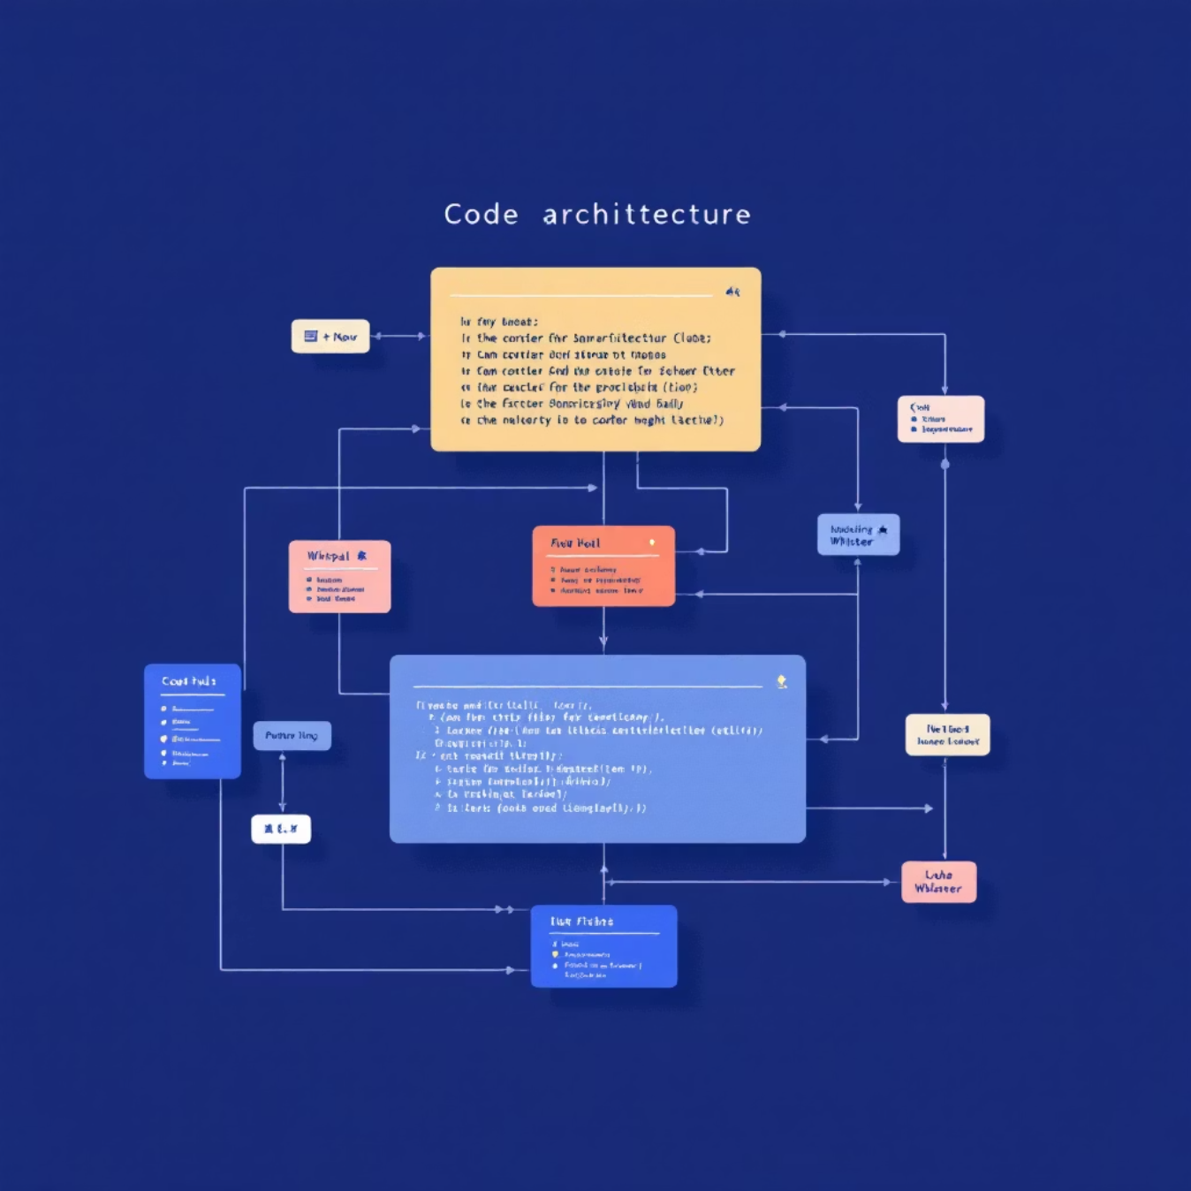
Building for Scale
Frontend Architecture
Our frontend leverages React's component-based architecture to create a maintainable and scalable codebase.
Reusable Components
Each UI section broken into modular, reusable pieces
Scalability
Architecture supports easy expansion and feature additions
Organized Structure
This structure keeps code organized, eliminates duplication, and improves long-term maintainability.
Clear folder hierarchy: components, pages, and utilities

Slide 9
Overcoming Design Challenges
1
2
Screen Size Alignment
Color Consistency
Maintaining consistent visual alignment across diverse devices and screen resolutions required careful planning.
Selecting a cohesive color scheme that balances professional appeal with readability.
Solution: Implemented Flexbox and CSS Grid for responsive, adaptive layouts
Solution: Developed a simplified, strategic color palette with clear hierarchy
3
4
Simplicity vs. Appeal
Information Density
Balancing visual attractiveness with functional simplicity without overwhelming users.
Creating an informative dashboard that presents data clearly without appearing cluttered.
Solution: Applied consistent design patterns with generous white space
Solution: Used card-based layouts with strategic spacing and visual grouping

Slide 10

A Foundation for the Future
Project Outcomes
The Smart Delivery Dashboard frontend delivers a comprehensive solution that transforms delivery management through thoughtful design.
Clean Interface
Smooth Navigation
Structured Information
User-friendly design that reduces complexity and enhances comprehension
Intuitive pathways between sections with consistent patterns
Well-organized delivery data enabling quick insights and actions
This design establishes a solid foundation for future backend integration, real-time updates, and expanded functionality. The modular architecture ensures the system can grow and evolve with user needs.

